Slide 1
Case Study - Call of Duty
E - Sport
Wai Hoi Li
Hult International Business School - MsBA Cohort 2
Text Analytics and NLP

Slide 2
Agenda
Problems to answer
Methodology
Most talked team
Emerging topic

Slide 3
Problems to answer
Could the antagonistic behaviors display toward some teams/ players/followers be compared?
Common topics among each teams, or is it diverse?

Slide 4
Methodology
Used the teamFollowerTimelines folders
imports all and slice sample
100 per each

Slide 5
Polarity performance

Slide 6
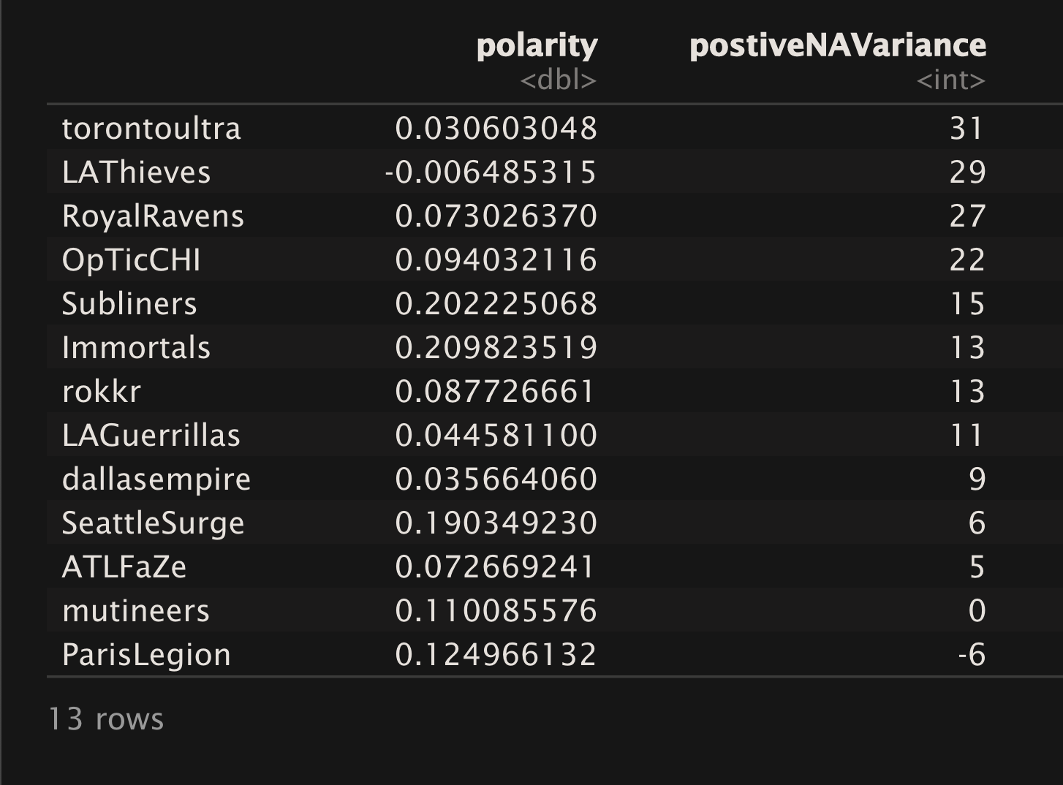
Polarity performance

Slide 7
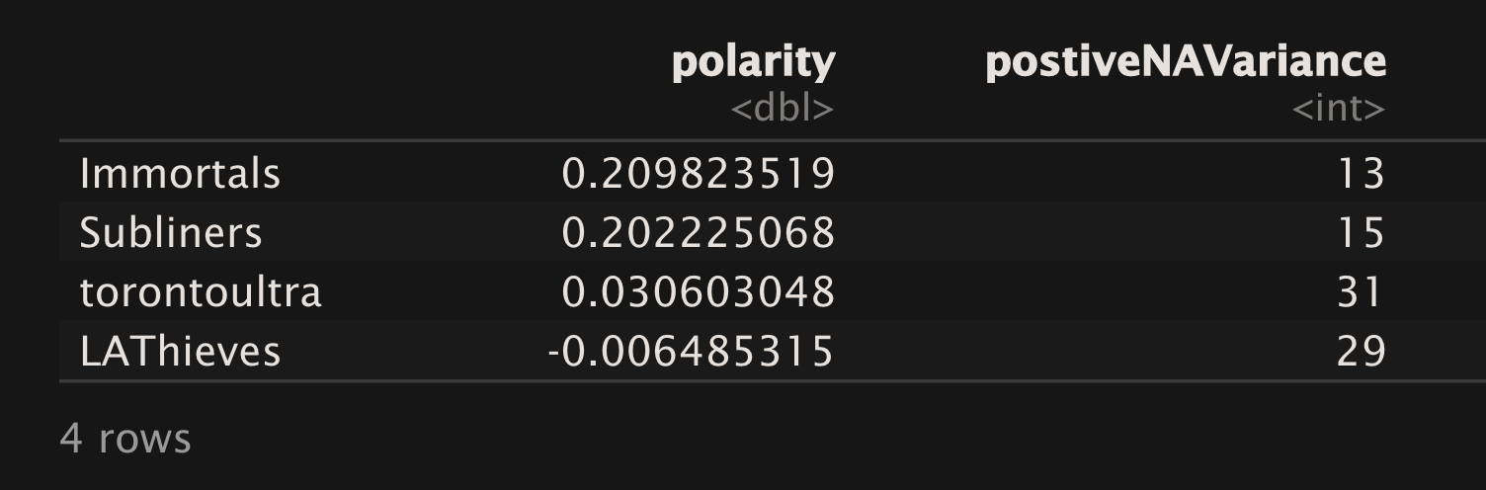
Polarity performance

Slide 8
Radar Chart

Slide 9
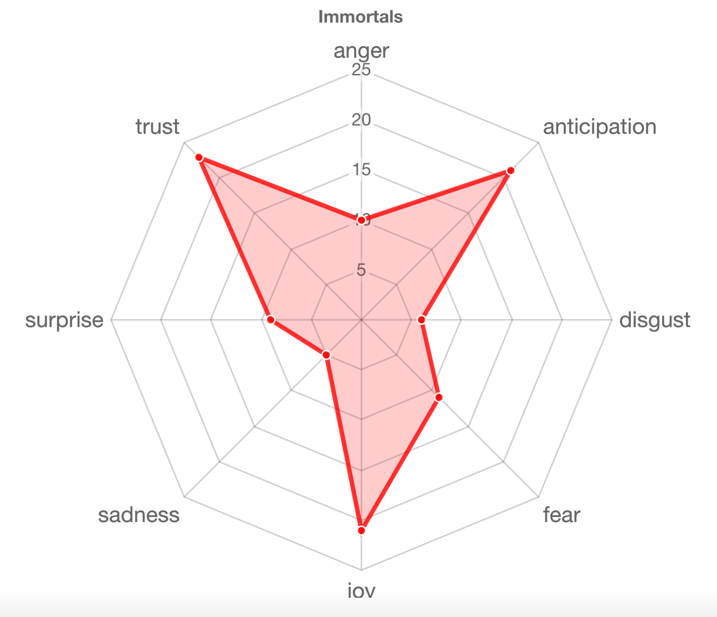
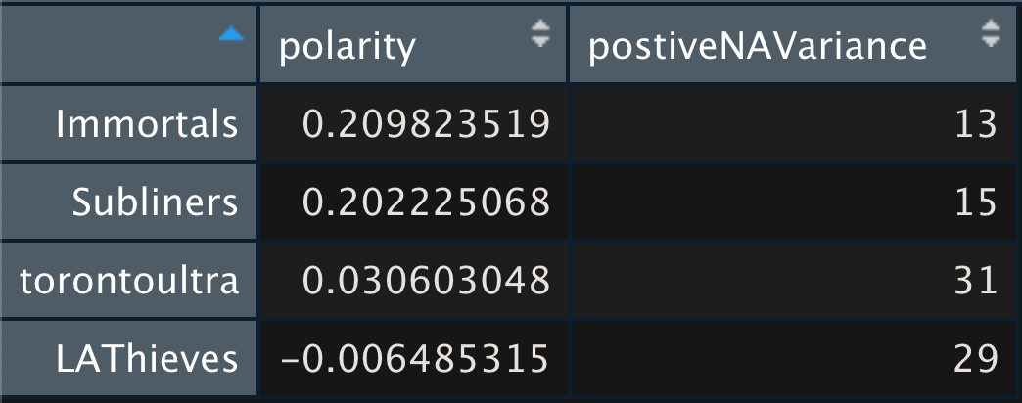
Immortals

Slide 10
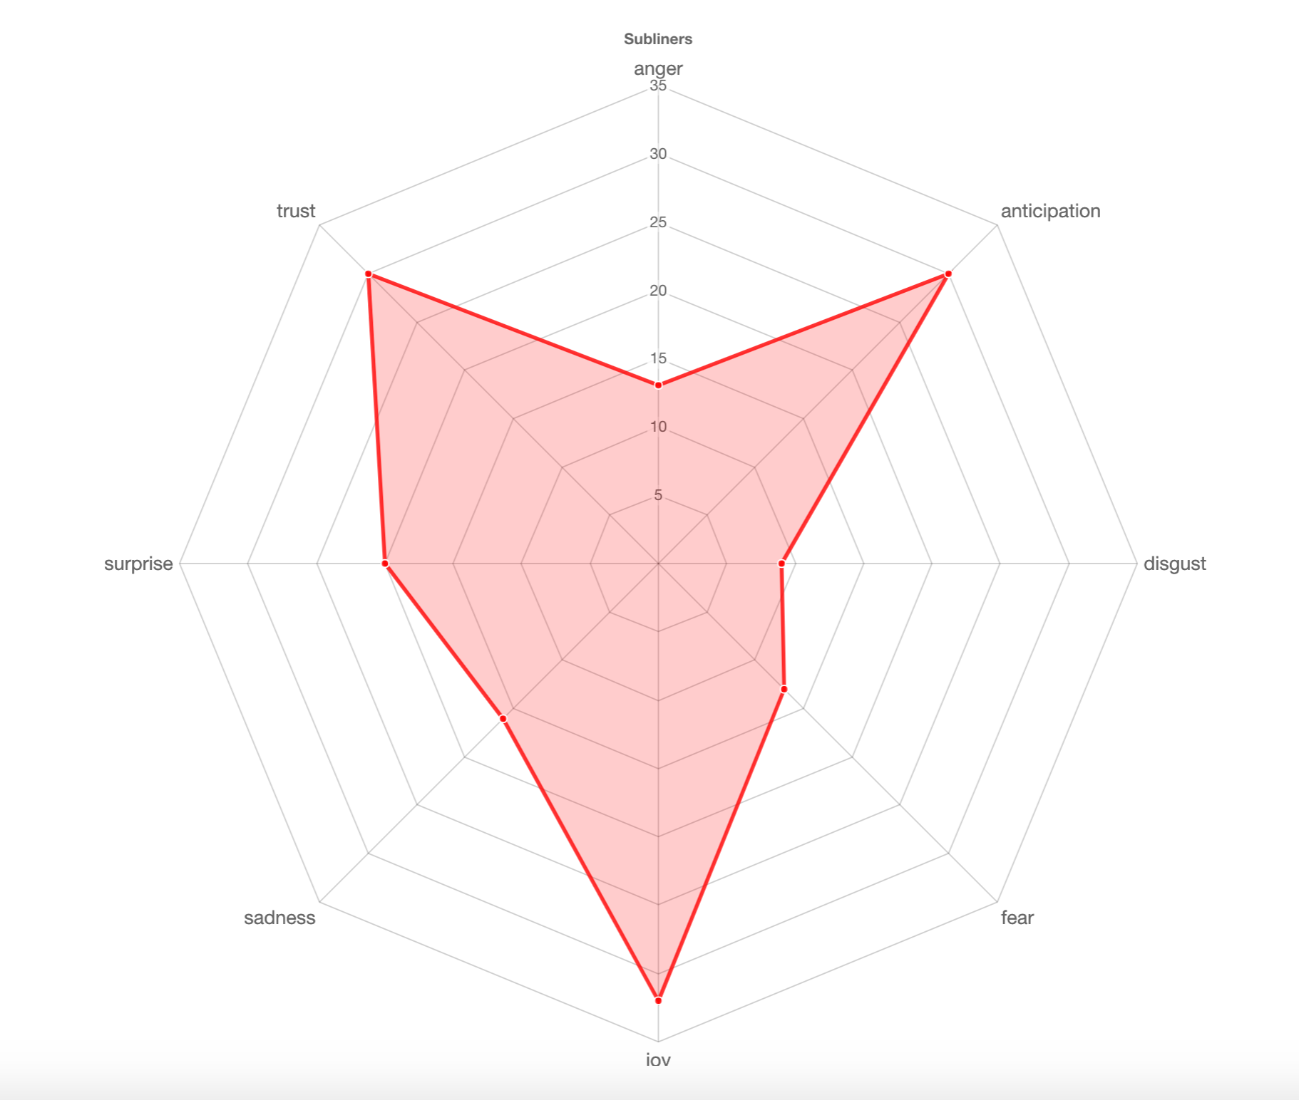
Subliners

Slide 11
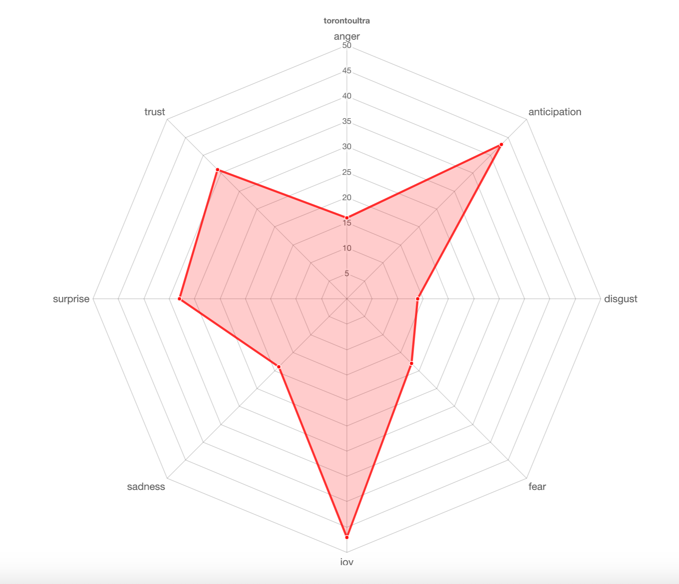
Toronto Ultra

Slide 12
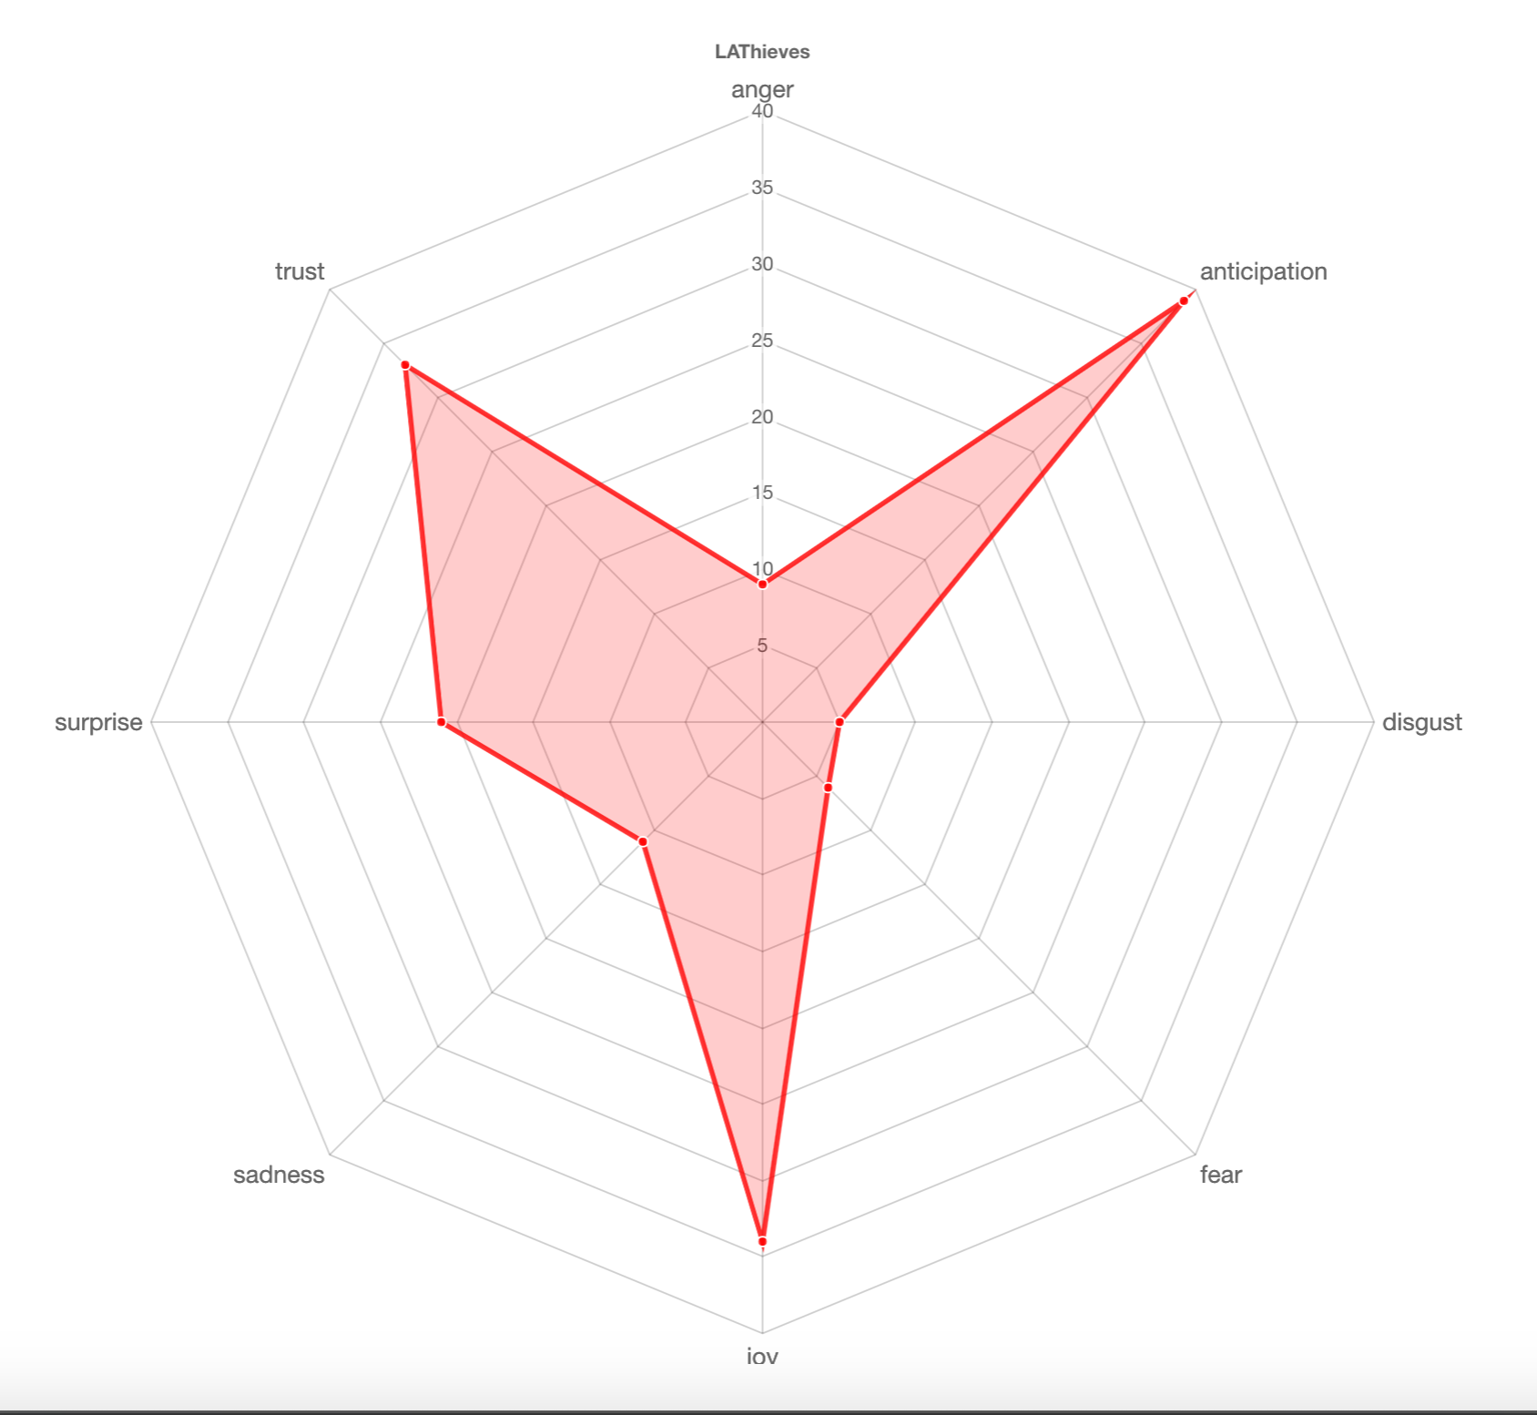
LA Thieves

Slide 13
Emerging Topic

Slide 14
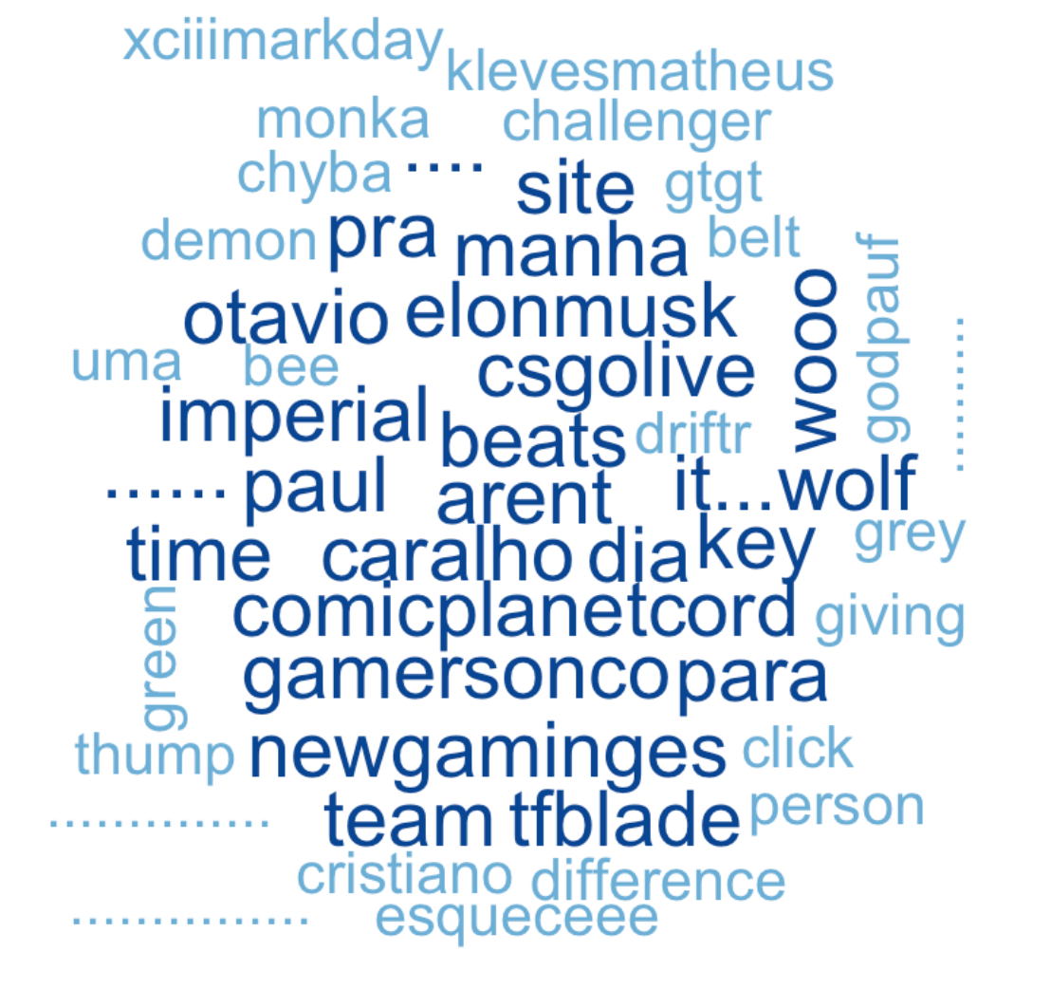
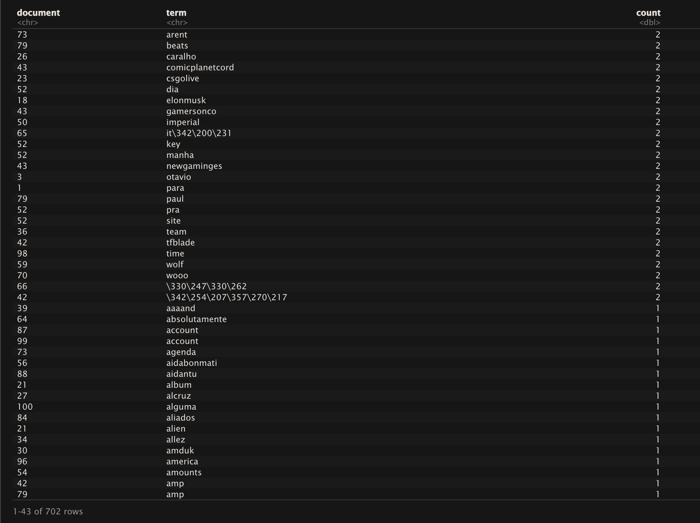
Immortals

Slide 15
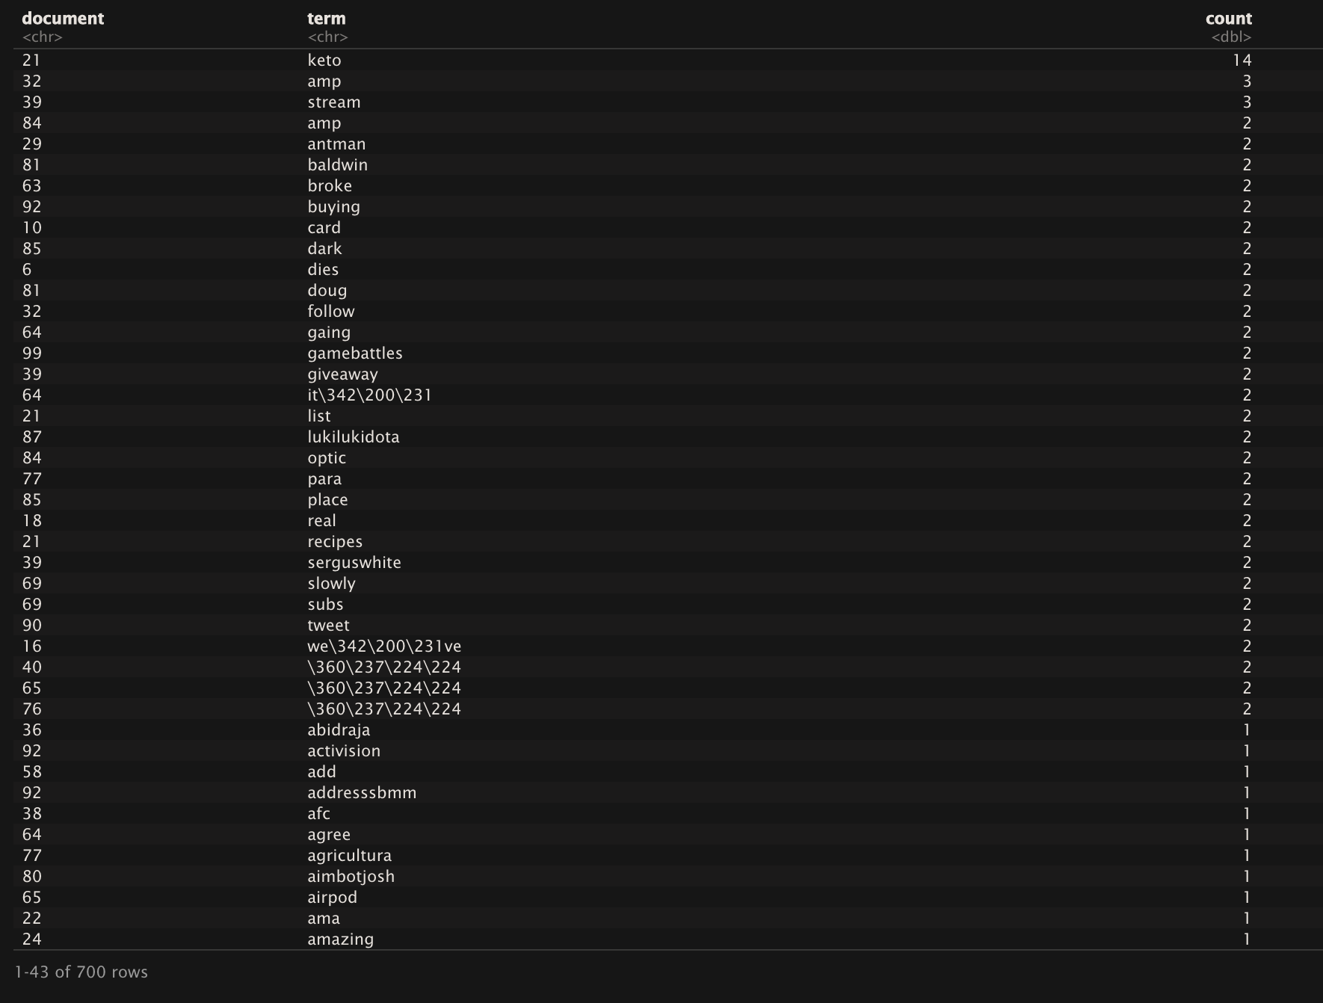

Subliners

Slide 16
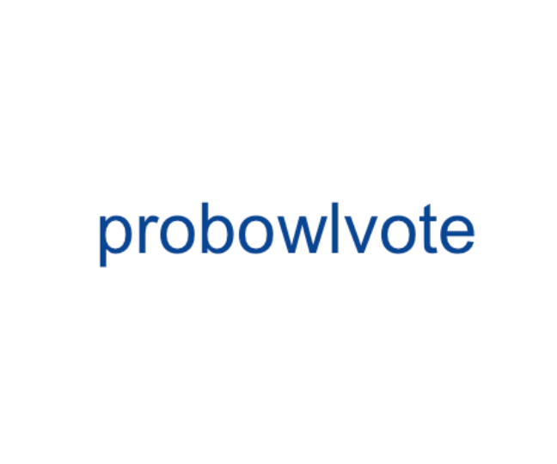
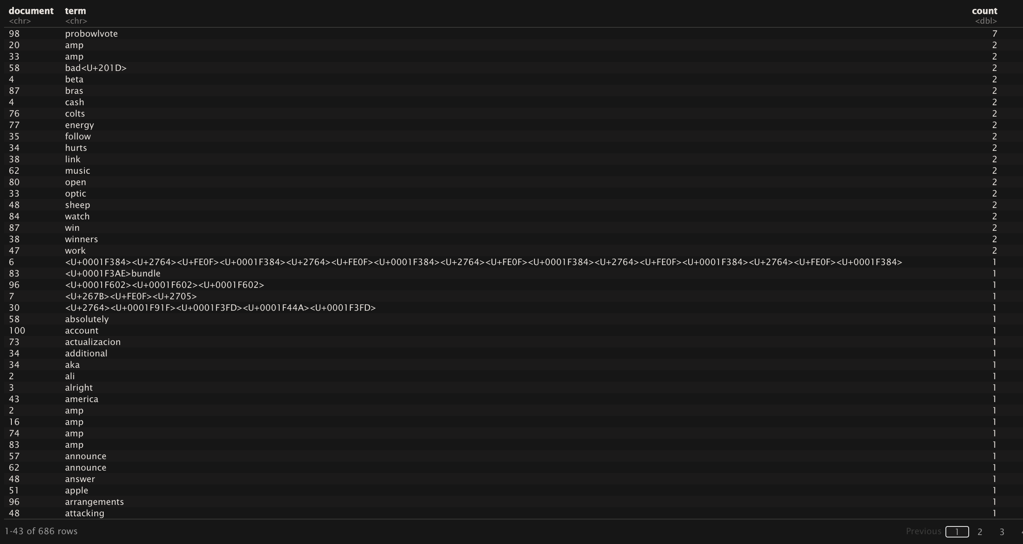
Toronto Ultra
Notes:
AMP - Pratical AMP -

Slide 17
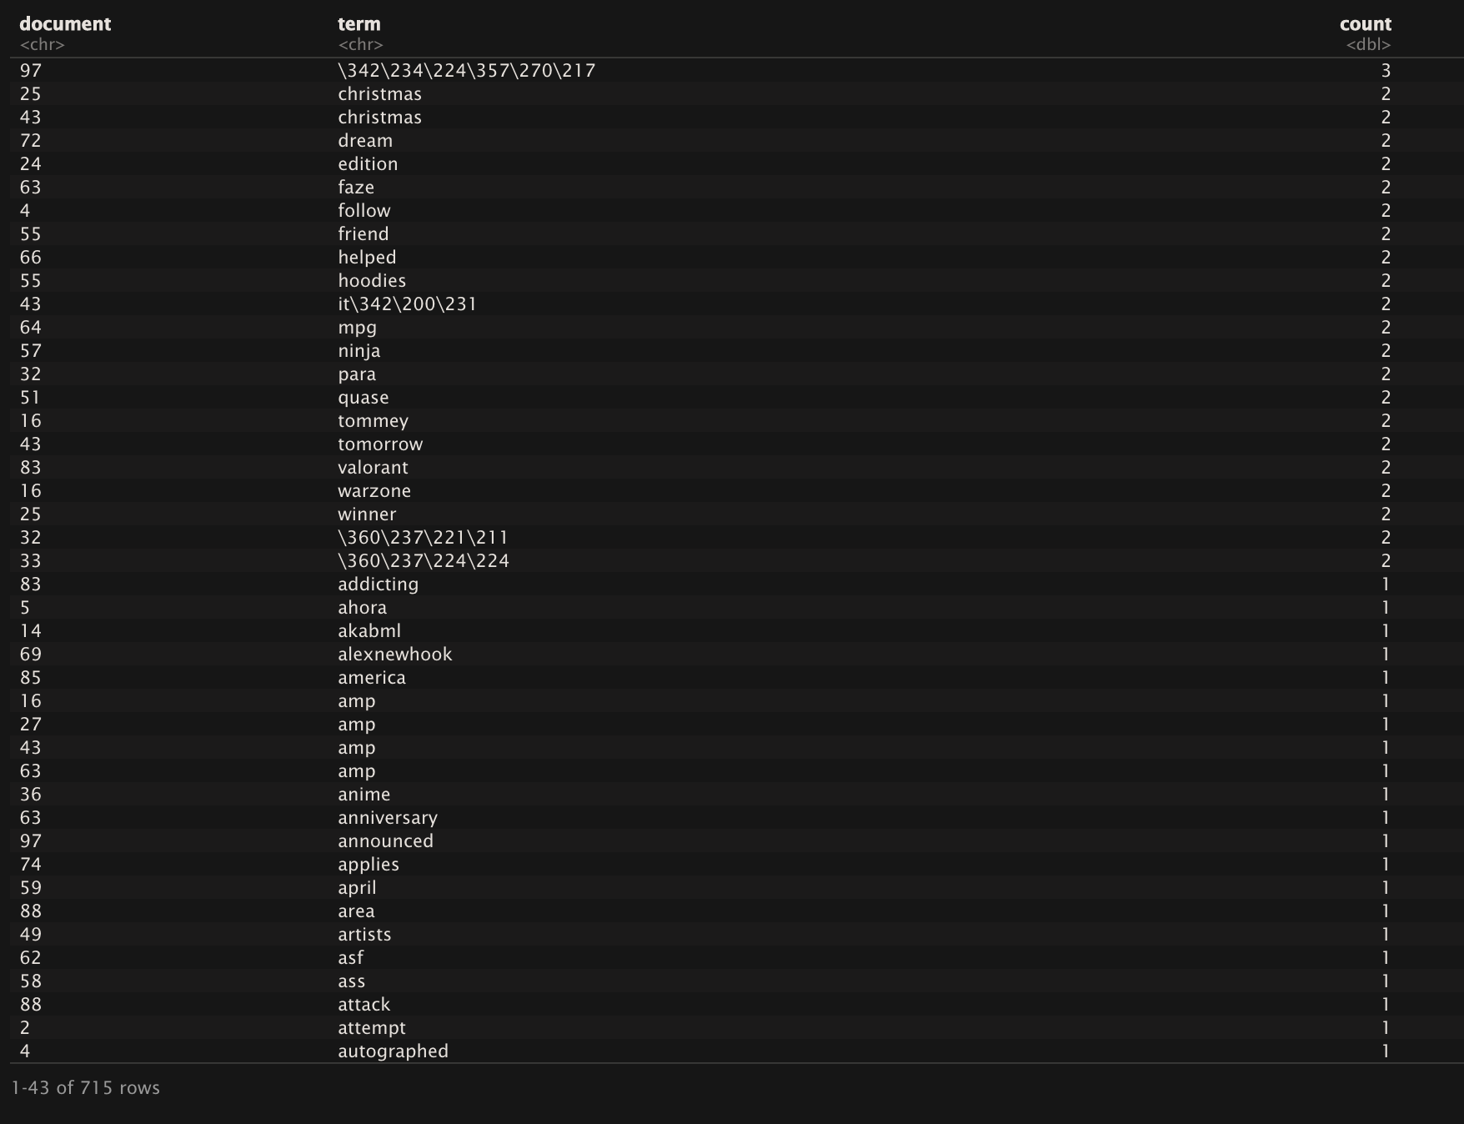

LA Thieves

Slide 18
Thank you for your attention!

